Slide 1


SMART INDIA HACKATHON 2024
InFlux
Charging ahead with seamless power
Problem Statement ID- SIH1595
Problem Statement Title- InFlux
Theme- Smart Vehicle
PS Category- Software
Team ID- MITADTSW337
Team Name- C2 Innovative

Slide 2
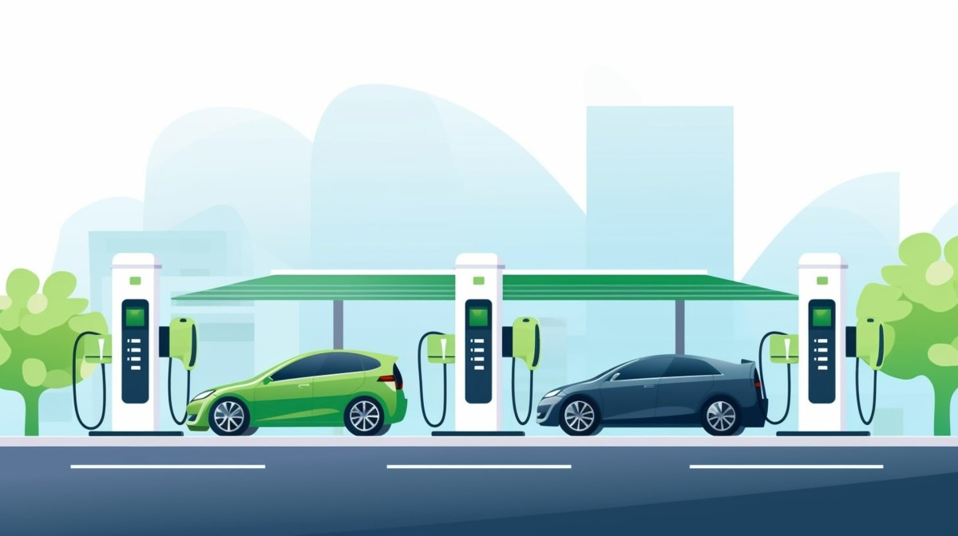
InFlux Charging ahead with seamless power
C2 Innovative
Proposed Solution
Provide a centralized website for locating EV charging stations.
Collaborate with all major EV charger brands.
Offer a unified wallet for easy payments across different chargers.

Slide 3



TECHNICAL APPROACH
C2 Innovative
A responsive website for real-time station discovery.
Integrate APIs from charger brands for location and availability data.
Secure online payment systems for the unified wallet.
Web-based GPS integration for station mapping and directions.

Slide 4

FEASIBILITY AND VIABILITY
C2 Innovative
Growing demand for web-based EV charging solutions with market growth.
Collaborating with brands reduces infrastructure challenges.
Secure payment systems ensure user trust and adoption.
Scalable for future additions like mobile compatibility.

Slide 5
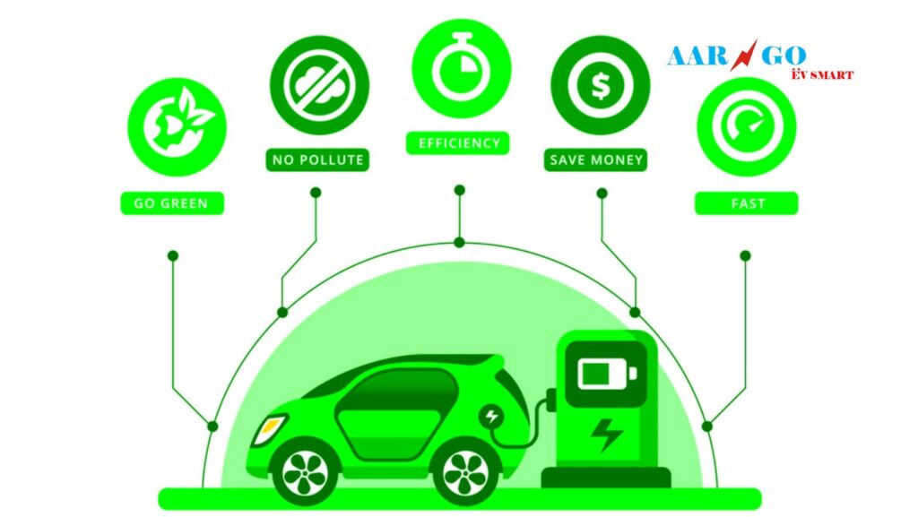
IMPACT AND BENEFITS
C2 Innovative
Simplifies the search for EV charging stations via a web platform
Unified wallet improves user convenience and transaction speed.
Strengthens the EV ecosystem by promoting green transportation.
Increases revenue for participating EV charger brands.

Slide 6
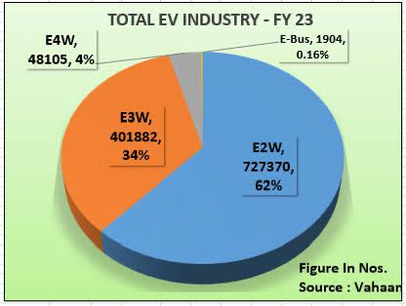
RESEARCH AND REFERENCES
C2 Innovative
Research Topic | Source
EV Growth Market | McKinsey Report 2023
Charger Network Expansion | IEA Global EV Outlook
Consumer Behavior Analysis | Deloitte Ev Survey
Unified Payment Systems | PwC Fintech Study

